Slide 1
Three Schema Architecture
By Falguni Bhavsar
Roll No - 07

Slide 2
What is Three Schema Architecture :
o The three schema architecture is also called ANSI/SPARC architecture or three-level architecture.
o This framework is used to describe the structure of a specific database system.
o The three schema architecture is also used to separate the user applications and physical database.
o The three schema architecture contains three-levels. It breaks the database down into three different categories.

Slide 3
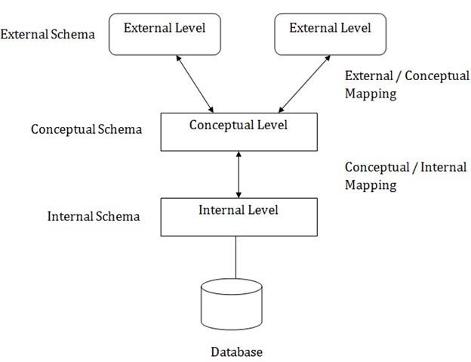
The three-schema architecture is as follows:

